Slide 1
Chapter 5 :
Power Supplies
Visit for more Learning Resources

Slide 2
Power Supply -
Convert the alternating current (AC) to direct current (DC) needed by the personal computer
Convert 110-240 V AC power from the mains, to several low-voltage DC power
Is the metal box
There are three types of power supply :
Linear power supply
Switch mode power supply (SMPS)
Uninterrupted power supply (UPS)

Slide 3
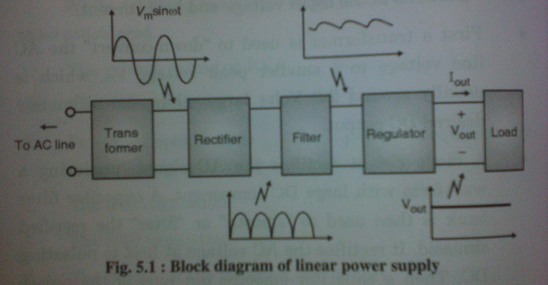
Linear Power Supply :

Slide 4
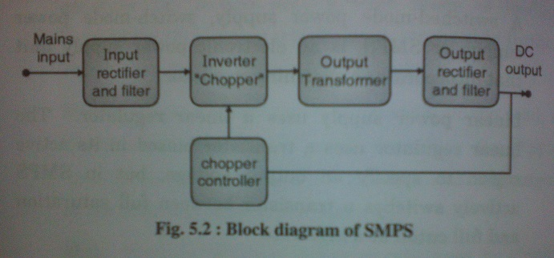
Switch Mode Power Supply (SMPS) :

Slide 5
Signal Description and Pinout of AT and ATX (Power Supply Form Factor) :
The versions popular power supply form factors are :
AT
ATX/NLX

Slide 6
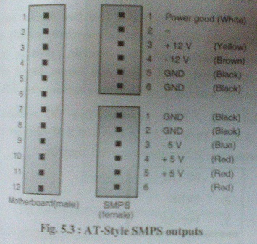
ATX Style SMPS :

Slide 7
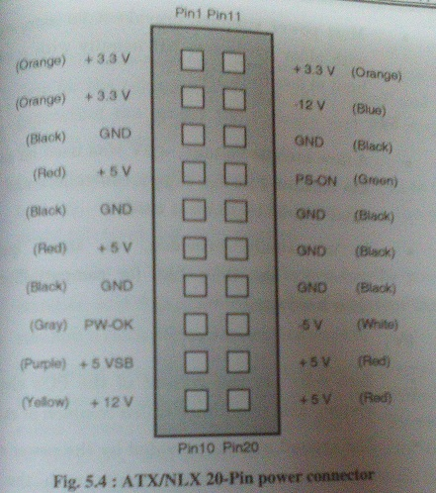
ATX / NLX Style SMPS :

Slide 8
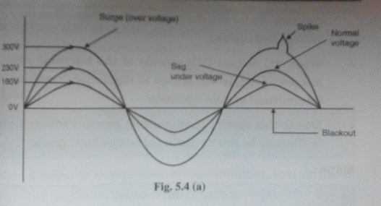
Power Problem :

Slide 9
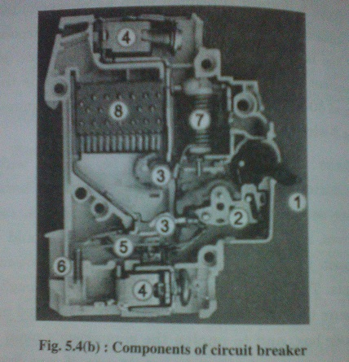
Circuit Breaker :

Slide 10
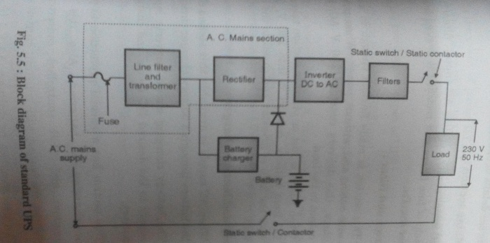
Block Diagram Of General UPS :

Slide 11
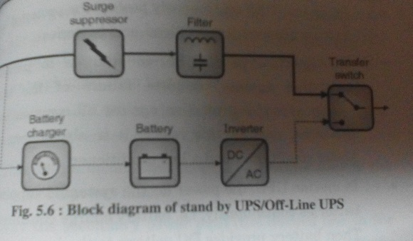
Stand by UPS / Off-Line UPS :

Slide 12
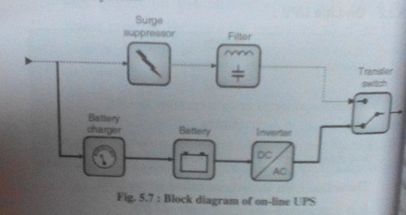
On-Line UPS :
For more detail contact us

